Slide 1
Karan Malhotra
Logistic Regression Cancer Modeling
Strand Life Sciences

Slide 2
Study Methods
Identified a set of commonly methylated CpG (Cytosine-Guanine) sites using data from the Cancer Genome Atlas and also genomic regions associated with cancer that commonly cited in literature
Defined a targeted panel of 595 genomic regions to which they aimed to identify in patient plasma samples
Interrogated regions in patient plasma samples using PanSeer assay, calculating the average methylation fraction (AMF) at each target region (identified 524 sites/595 target sites)

Slide 3
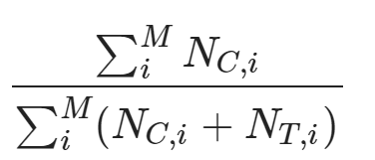
Average Methylation Fraction (AMF)
Legend:
M = Total CpG Sites across entire region
i = 1 identified CpG site in target region
NC,i = Total cytosines observed at CpG site, i
NT,i = Total thymines observed at CpG site, i

Slide 4
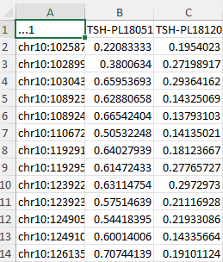
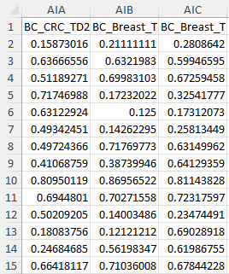
Raw Data
Average Methylation Fraction (AMF)
patientID of plasma sample
TSH Data
Biochain Data
Chromosomal Target Region (ranges from 3-228 chromosomes covered per region;
average chromosomal coverage: 50;
total chromosomal coverage: 35,361)

Slide 5
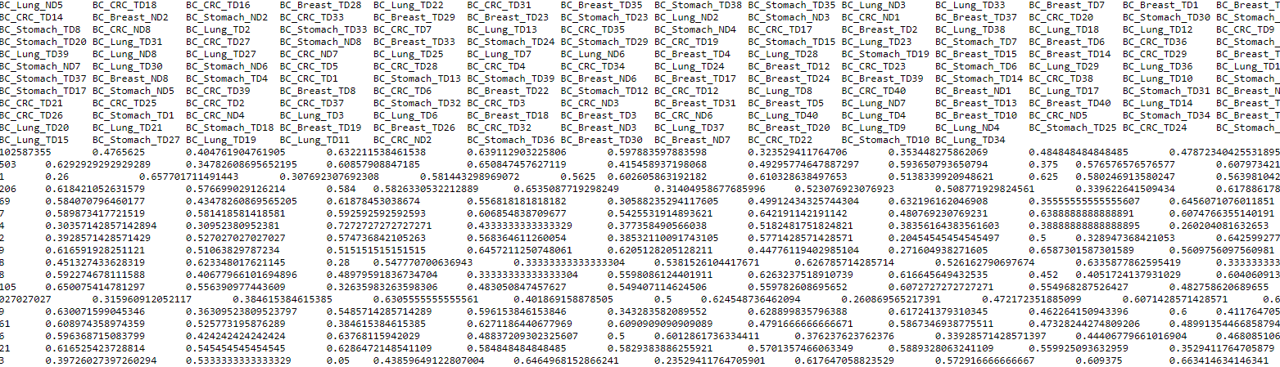
Biochain Tissue Samples
200 DNA samples taken from fresh cancer tissue (breast, lung, colorectal, liver, stomach, and esophageal) and healthy tissue
Raw Data

Slide 6
Analysis of Biochain Tissue Samples
These samples were used to identify statistically significant target regions for distinguishing between cancerous and non-cancerous samples; These sites would later be used to build the logistic regression model.
Only target regions identified across all samples were used (rows with blank cells are deleted and total target sites goes down from 616 to 524)
Benjamin-Hochberg correction T-test is conducted across all regions
Total region markers is now down to 477 identified to be statistically significant, which will be used for training of the logistic regression model

Slide 7
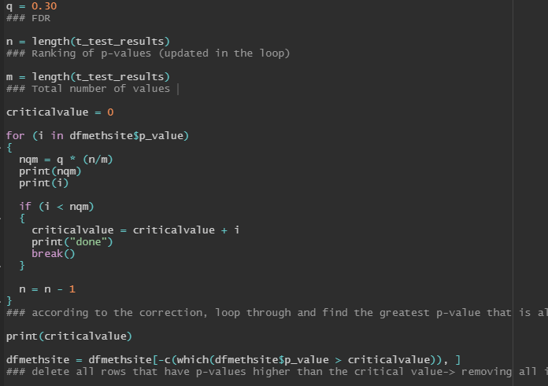
Benjamin-Hochberg Correction
First, a normal T-test is conducted across all samples
P-values are sorted in descending order (Hochberg correction sets the significance level as the highest p-value that is less than its critical value (nqm))
Looping through each value, checking whether the value is less than the nqm corrected value.
When we find one, that is set as the critical value
Any p-values that are greater than the critical value are discarded from the list, and those regions are considered insignificant
Remaining: 477 significant target regions for comparison

Slide 8
TSH Model Creation

Slide 9
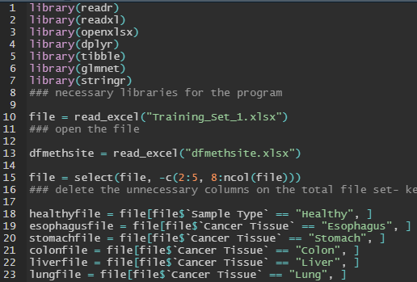
Data Preparation Methods

Slide 10
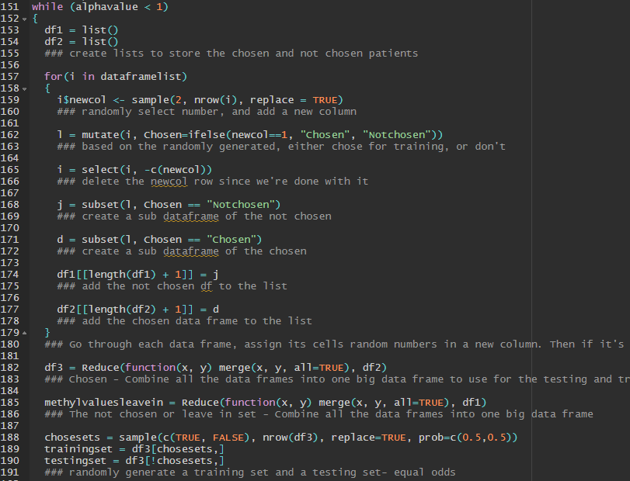
Data Preparation Methods
First Random Split: Leave-in and Leave-out sets
Second Random Split: Training and Test Set

Slide 11
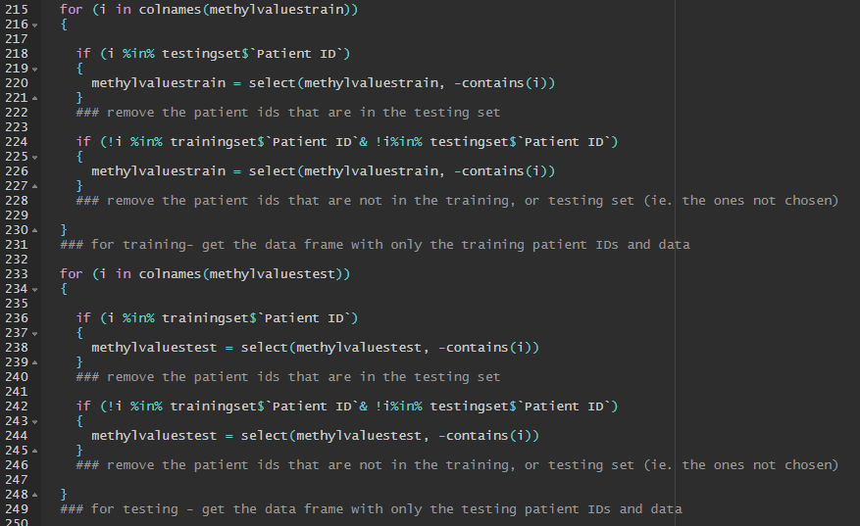
Data Preparation Methods
Creating data frames of only training and test sets

Slide 12
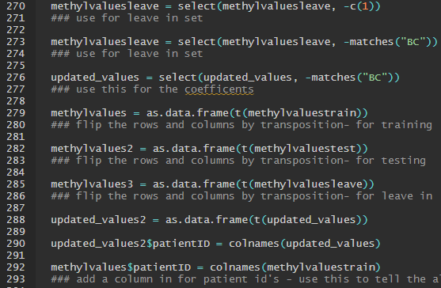
Data Preparation Methods
Get rid of biochain samples
Transform all data frames
Add in patientIDs for reference

Slide 13
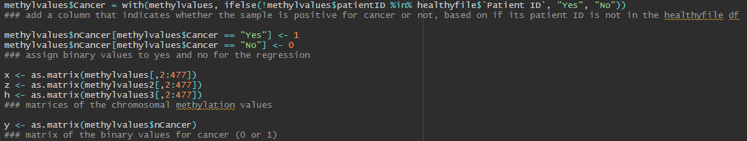
Logistic Regression Model Preparation
Add in binary values for regression model

Slide 14
Elastic Net Regression
Ridge Regression
Coefficients of the variables with less contribution to the model are reduced to close to zero; all coefficients are still used in the model
Lasso Regression
Only the most significant variable coefficients are used in the model; coefficients of variables without significance are reduced to zero
Elastic Net Regression
Combination of ridge and lasso modeling— some coefficients are reduced to close to zero (ridge), others are reduced to exactly zero (lasso)

Slide 15
cv.lasso
Alpha value defines the type of model used
1 = lasso regression
0 = ridge regression
0<alpha<1 = elastic net regression
Calculate the optimal lambda value for the model
Lambda = amount of shrinkage in the model

Slide 16
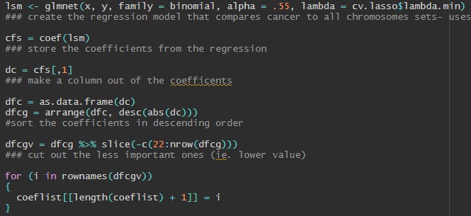
Penalized Logistic Regression Model
Glmnet logistic regression model
Optimal lambda value
Optimal alpha value
Store coefficients with greatest weight in the model

Slide 17
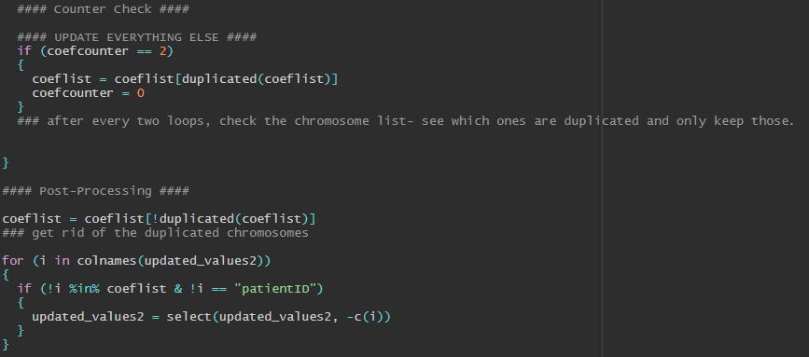
Model Coefficients
Only take coefficients that appear two times in a row (in the highest weighted coefficient list) while looping

Slide 18
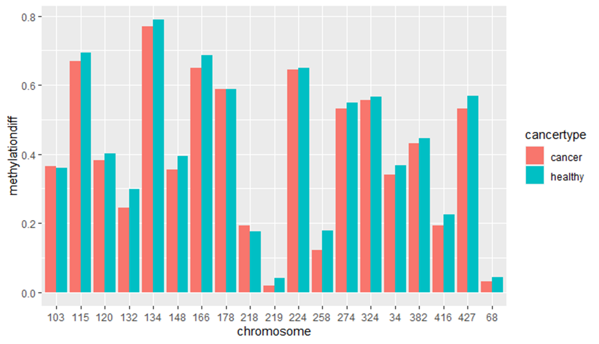
Mean Comparisons of Model Coefficients (Cancer vs. Healthy)

Slide 19
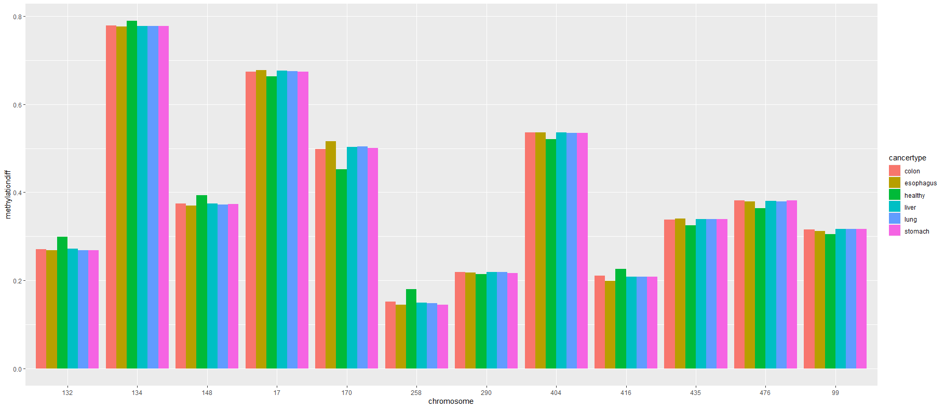
Mean Comparisons of Model Coefficients (Among Cancers)
Notes:
This one followed a stricter rule for including target regions- appearance 3 times instead of 2 (previous slide)

Slide 20
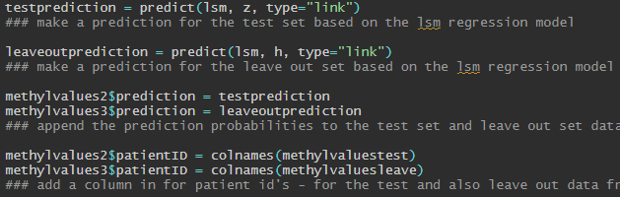
Logistic Regression Model Predictions
Make a prediction on the test set
Make a prediction on the leave-out set

Slide 21
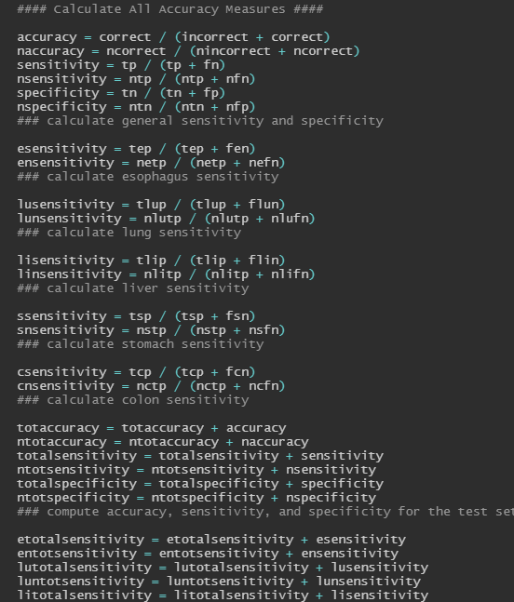
Model Calculations
Calculate average accuracy, sensitivity, and specificity for test and leave-out sets
Calculate sensitivity for each cancer type
The model loops through alpha values (5 runs per alpha value), storing average sensitivity, specificity and accuracy at each value

Slide 22
Model Results

Slide 23
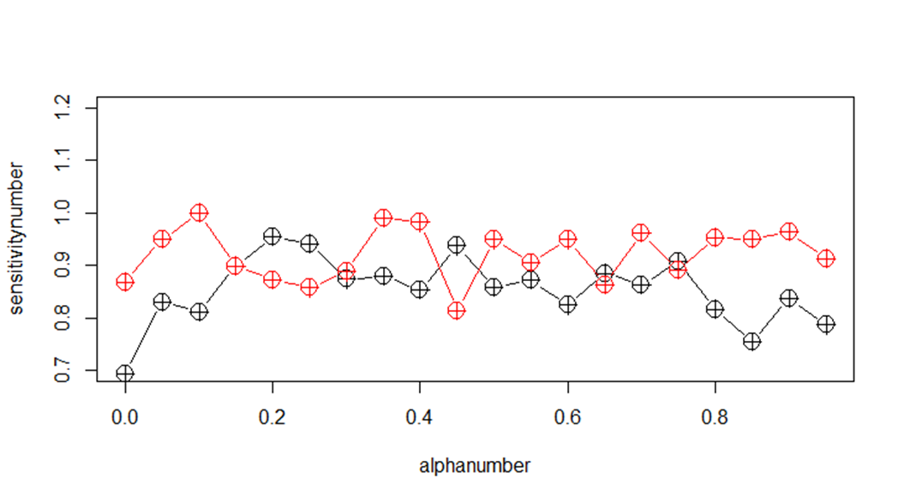
Generalized Model Sensitivity/Specificity (Healthy vs. Cancer)

Slide 24
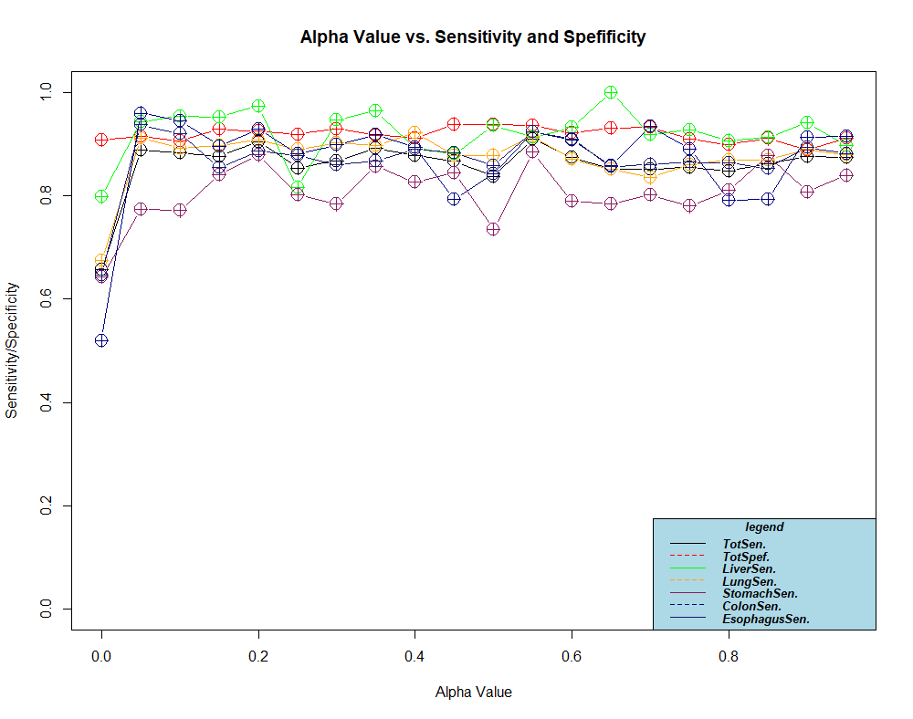
Total Specificity/Sensitivity

Slide 25
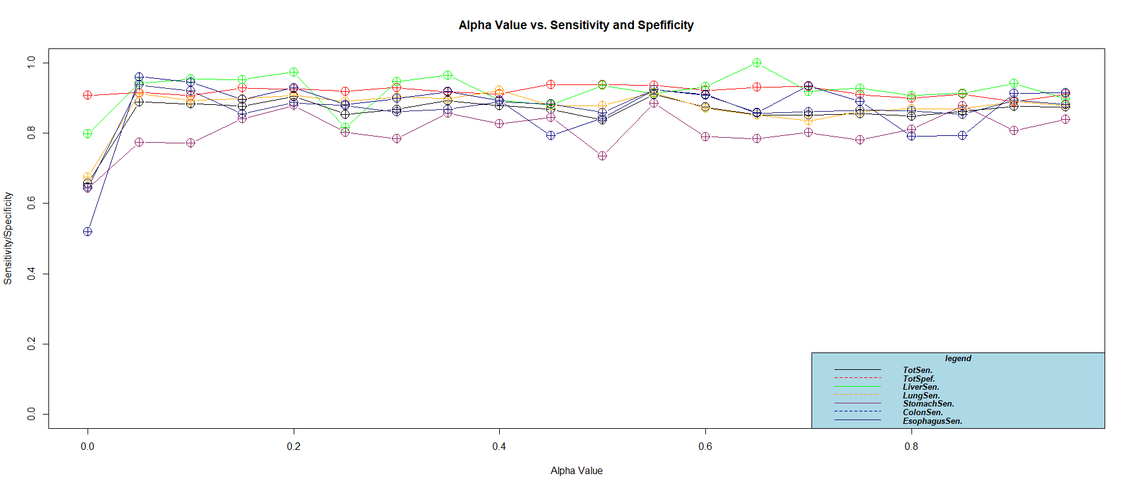
Total Specificity/Sensitivity

Slide 26
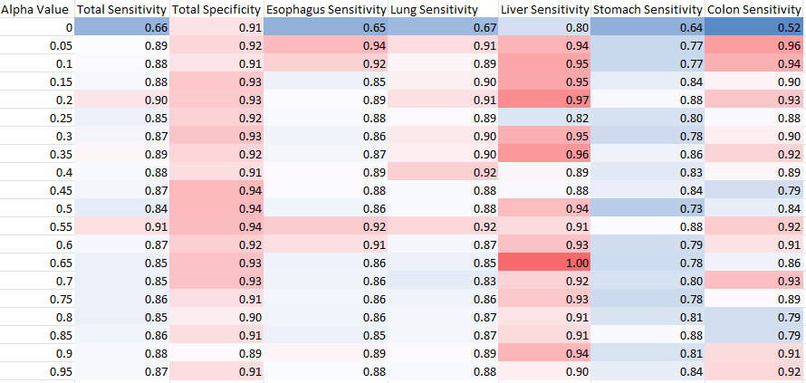
Sensitivity Results (Alpha Value)

Slide 27
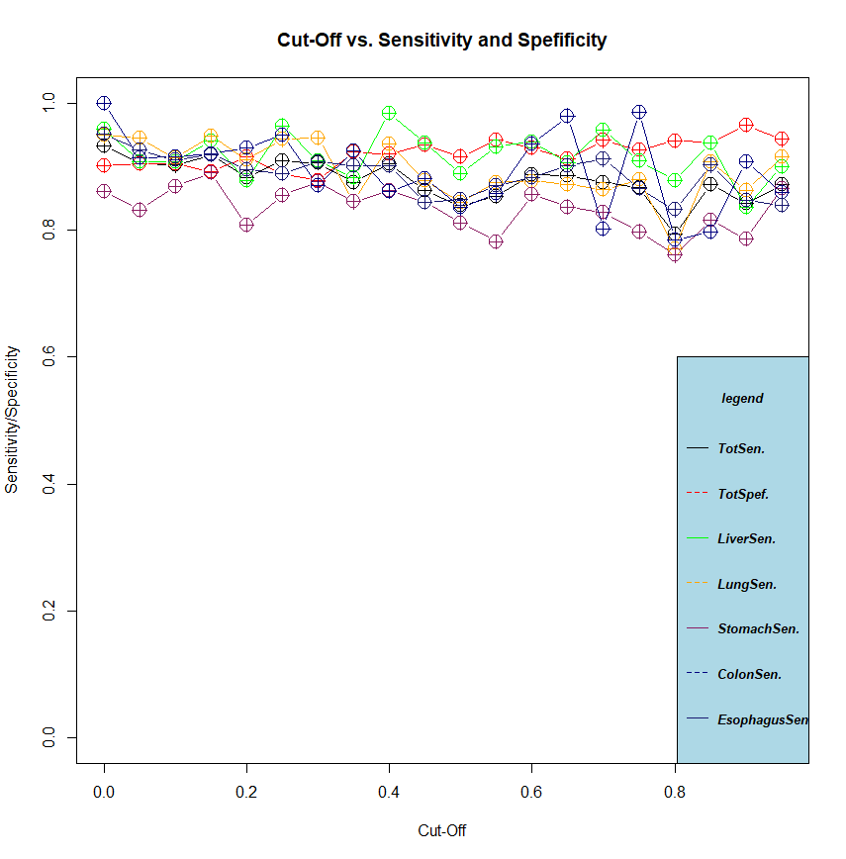
Sensitivity Results (Cut-Off)

Slide 28
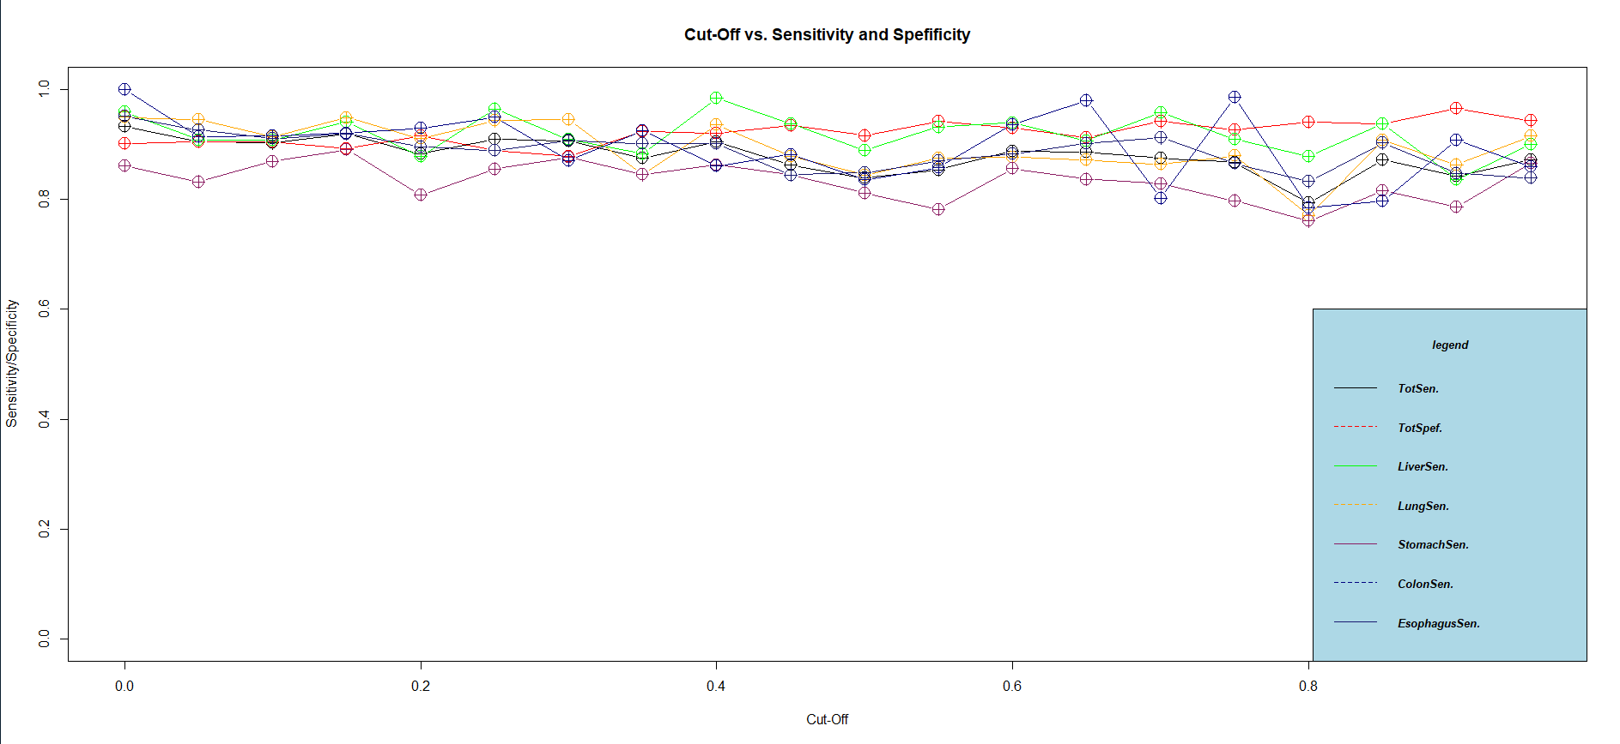
Sensitivity Results (Cut-Off)

Slide 29
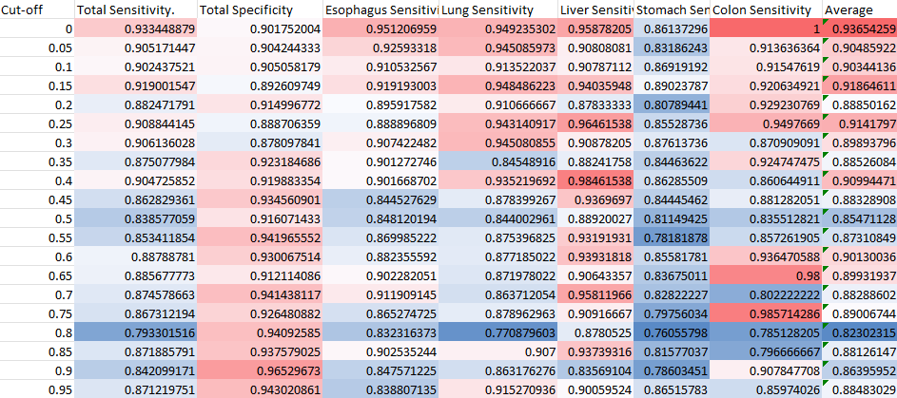
Sensitivity Results (Cut-Off)

Slide 30
Multinomial Regression and Discriminant Analysis
Model was unsuccessful-> returned 50% accuracy at peak. (Tested multinomial regression, LDA, MDA, FDA, QDA, and RDA)

Slide 31
Limitations
1. Sample set is too small; some cancers have as low as 3% variance in the training set, which makes model building, data profiling, and differentiation between cancer types difficult
2. There is not covariance among the cancer types— ie. Esophageal cancer makes up, on average, 30% of cancers, while colorectal is only 5%. This tends to severely bias the modeling, and affects the accuracy of some modeling methods like LDA which require covariance in the training set to be successful
3. The target regions interrogated in this study were general methylation sites, implicated across various cancers, and not specific to one cancer type. Accordingly, this likely means that distinction between the AMF’s among the cancer types is too insignificant to provide true differentiation. There were larger differences among the means of healthy vs. cancer samples, which makes the general distinction easier, however, among the specific cancer types, the differences aren’t as sizable (demonstrated in comparative bar graphs referenced on slides 18 and 19).

Slide 32
Mean Comparisons of Sample Model Coefficients (among cancers)

